Slide 1


PDF Analyzer
Semantic Chunking, Summarization & Chat over PDFs
Presented by Pratham Israni

Slide 2

The Unsolved Problem of Semantic PDF Chunking
Scientific papers have inconsistent formatting: Some use bold titles, some ALL CAPS, some numbered. There’s no standard rule that applies across all documents.
Visual layout ≠ semantic structure: PDFs often have multi-column text, figures, footnotes, or headers that break traditional regex or positional logic.
No existing AI can chunk PDFs semantically at scale: Even advanced LLMs (GPT, Claude, etc.) can't semantically segment entire PDFs into meaningful sections without manual prompt engineering.
Regex and heuristics fail beyond 50%: Your current rule-based chunker handles standard papers, but fails for non-standard formats — proving that handcrafted logic isn’t scalable.
Poor chunking = poor AI understanding: If chunks are misaligned, summarizers and chatbots lose context, resulting in weak answers or hallucinations.
Still an open research problem: Despite tools like SciSpace or Semantic Scholar, there’s no generalized, open-source solution for semantic chunking of arbitrary PDFs.

Slide 3

The Genesis of PDF Analyzer
The inspiration struck during a hackathon, not from the original problem statement but from observing the inefficiencies in processing PDFs. Research quickly confirmed the glaring absence of robust semantic chunking solutions.
Initial attempts with GPT and regex covered about 50% of use cases, highlighting a core issue: the lack of a universal logic for all PDFs. This realization spurred the decision to develop a custom AI, designed to understand and chunk documents based on their true structural semantics.

Slide 4





Core Features & Capabilities
PDF Analyzer integrates several key functionalities to deliver a seamless document interaction experience.
PDF Upload & Parsing
Semantic Chunking
Embedding Generation
Effortless document ingestion and text extraction using PDF.js.
Intelligent sectioning based on heading detection, content size, and regex patterns.
Leveraging Xenova Transformers with an efficient caching mechanism for fast vector creation.
Summarization
Interactive Chat
Concise summaries generated via OpenAI, with a robust Xenova fallback and batching for large documents.
Contextual conversations powered by cosine similarity, vector search, and OpenAI responses.

Slide 5
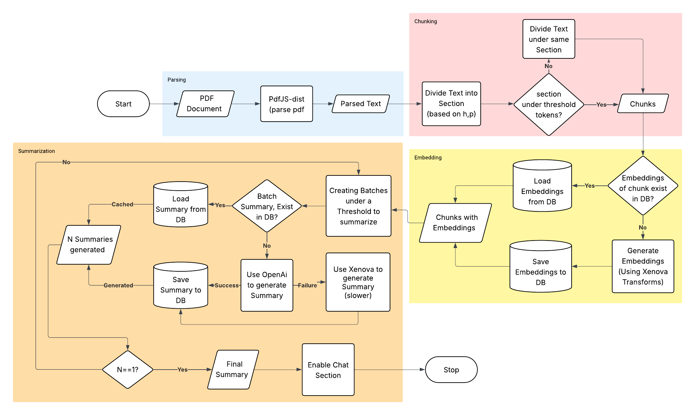
Flowchart Of Summarization and PDF Analyzer

Slide 6
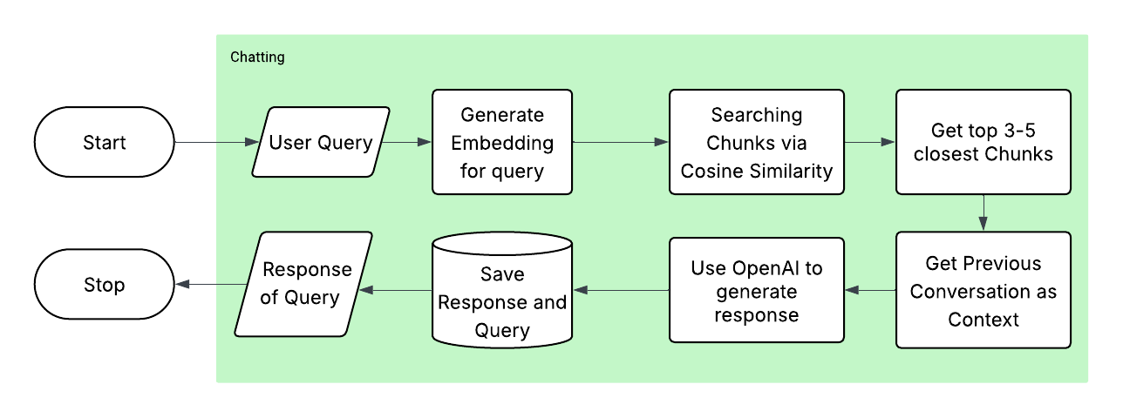
Flowchart Of User Query and Interactive chat

Slide 7

Current Status & Progress
We have successfully developed a robust prototype that demonstrates the core functionalities of the PDF Analyzer.
Rules-Based Semantic Chunking: The system currently employs a rules-based approach for effective semantic chunking, providing reliable section identification.
Functional Summarization & Chat: Both document summarization and the interactive chat features are fully operational, offering immediate value to users.
AI-Based Chunking Logic in Development: Significant progress has been made on the advanced AI model designed for more adaptive and accurate chunking, which will be integrated soon.

Slide 8
THANK YOU
By: Pratham Israni

